Slide 1


Gözel’s Media Literacy Starter Kit
https://shakeri.eu
Notes:
What *you* can do to resist and reform our digital media landscapes.

Slide 2



Free Resources
Media Literacy Starter Kit incl.
5-step Guide towards more Media Literacy
Quick Guide to recognising AI generated content
Bonus: 5-day media detox / literacy challenge
Reading recommendations
https://shakeri.eu
Notes:
I will quickly glossing over … overview of all the things … show you what I prepared for you – for the NerdNite audience specifically. You can get all resources and tips and links and academic literature from this talk on my website. I will provide link and QR code at the end.
….
I will very quickly go over these resources so you know they exist. Let’s go.

Slide 3
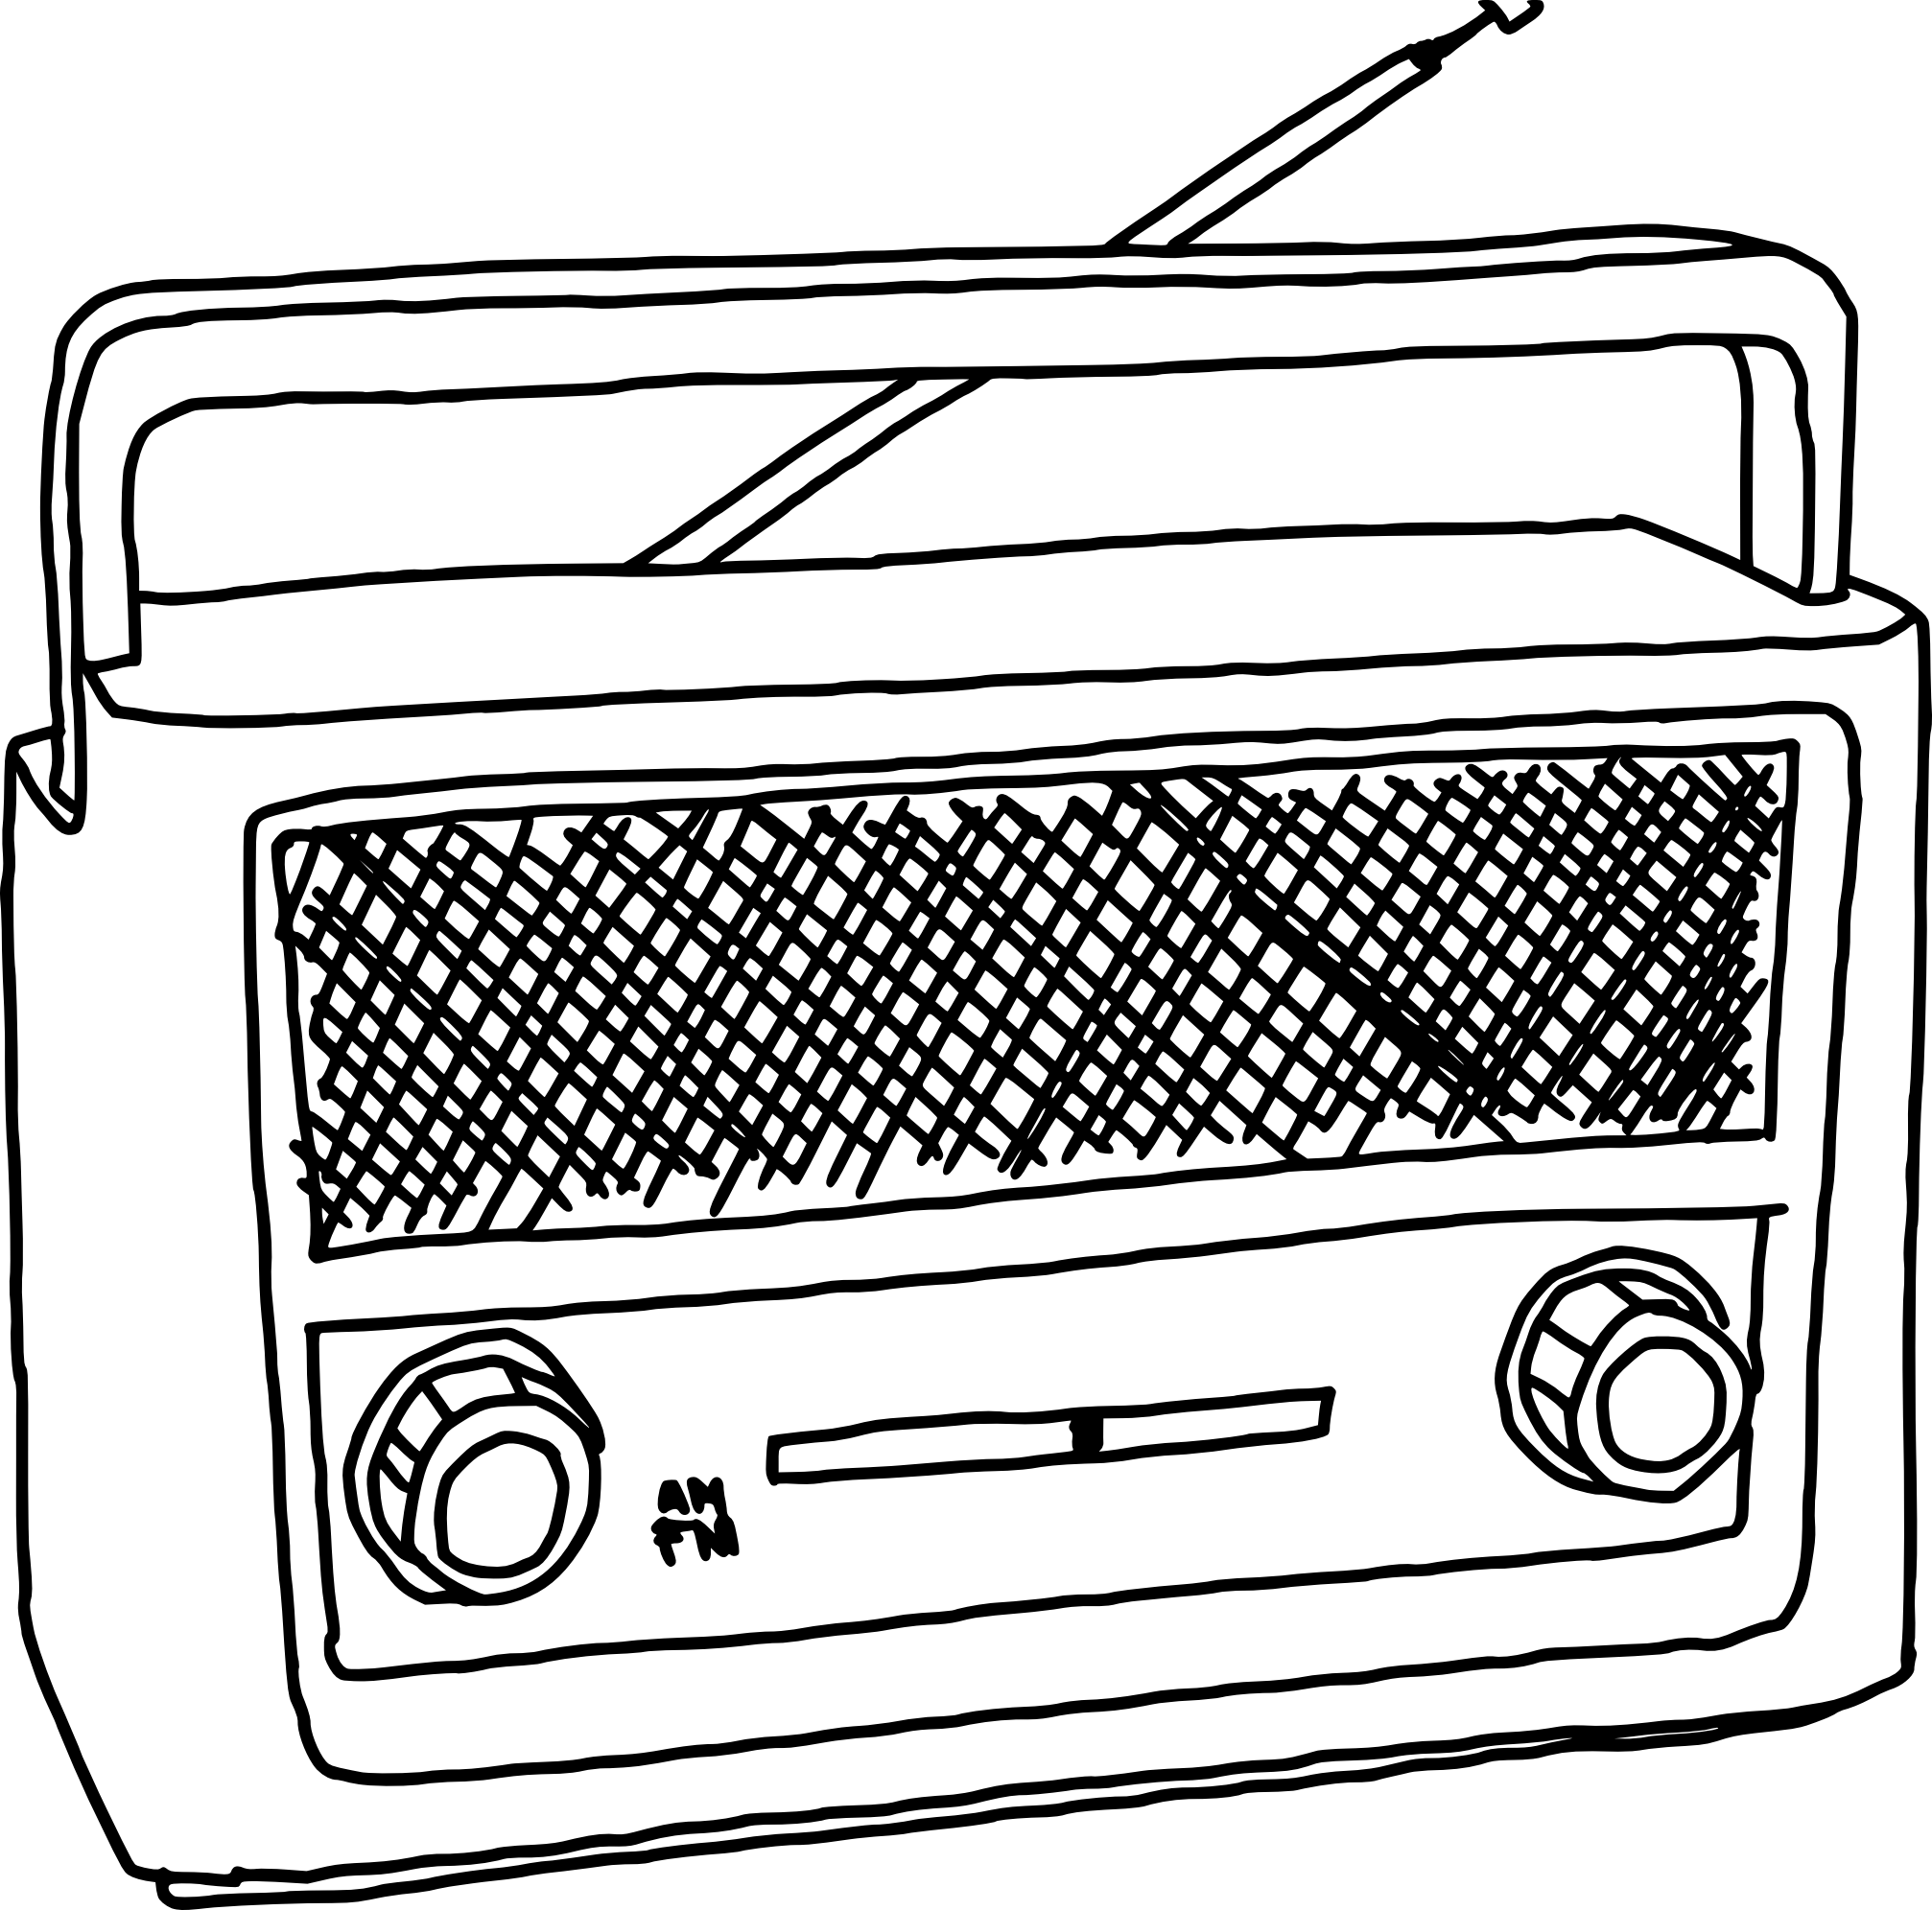




Applicable to all media
https://shakeri.eu
Notes:
And the tools and techniques I share with you today are applicable across all media, not only social media or YouTube.

Slide 4
Media Literacy Starter Kit
Resources to explore:
Data Detox Kit: https://datadetoxkit.org
Algorithmic Justice League: https://www.ajl.org/library/home
Crash Course Media Literacy: YouTube Series
National Association for Media Literacy Education: https://namle.org/
Personal favourites:
ad-blockers: e.g. uBlock origin, AdBlock Plus, adguard, Ghostery, etc
change your settings to make yourself less available to ad targeting (e.g. Facebook and Instagram) through tutorials on Data Detox Kit
https://shakeri.eu

Slide 5

5-step Guide towards more Media Literacy
Understand the source
Verify Information
Analyse the Message
Recognise Bias and Perspective
Engage Critically and Ethically
https://shakeri.eu

Slide 6
1. Understand the Source
Why it matters: Not all sources are created equal. Knowing who produced the content, their motivations, and their credibility is crucial.
How to do it:
Check the author’s credentials and expertise.
Investigate the publisher or platform (e.g., is it a reputable news outlet, a blog, or a social media account?).
Look for biases or potential conflicts of interest.
Tip: Use tools like Media Bias/Fact Check to evaluate the reliability of news sources. Be vigilant about people who provide “simple” explanations to complex issues.
https://shakeri.eu
Notes:
First of all, understand the source of your information. I describe why it matters, how to do it, and I provide tools and tips to getting you started.

Slide 7
2. Verify Information
Why it matters: Misinformation and disinformation are widespread. Verifying facts helps you avoid spreading false information.
How to do it:
Ask: Is it fact or opinion? Cross-check information with multiple reputable sources.
Use fact-checking websites like Snopes, FactCheck.org, PolitiFact or Wikipedia’s List of fact-checking websites.
Use fact-cheking browser extensions like NewsGuard or Media Bias/Fact Check.
Look for primary sources (e.g., official reports, studies i.e. Google Scholar, or direct quotes) whenever possible.
Tip: Be wary of sensational headlines or content that evokes strong emotions—these are often red flags for misinformation.
https://shakeri.eu
Notes:
Second, verify information.
In the spirit of Media Literacy, I challenge you to check out the resources I provide and make up your own mind about what the scientific literature says. Or find your own sources!

Slide 8
3. Analyse the Message
Why it matters: Media messages are often designed to persuade, entertain, or manipulate. Understanding the intent behind the content helps you interpret it critically.
How to do it:
Ask: Who is the target audience? What is the purpose of this message?
Identify persuasive techniques, such as emotional appeals, loaded language, or cherry-picked data.
Consider what is not being said—are there gaps or omissions in the information?
Tip: Learn about common logical fallacies (e.g., straw man, false dilemma) to spot flawed arguments.
https://shakeri.eu
Notes:
Analyse the message.

Slide 9
4. Recognise Bias and Perspective
Why it matters: All media content reflects some level of bias or perspective. Recognising this helps you interpret information more objectively.
How to do it:
Compare how different outlets cover the same story.
Be aware of your own biases and how they might influence your interpretation.
Look for diverse perspectives, especially on controversial topics.
Tip: Use tools such as AllSides to shows bias ratings for news outlets or stories or help you understand persuasive techniques used in specific ads to influence buyers. Follow a range of news sources with different political leanings to get a balanced view.
https://shakeri.eu
Notes:
Fourth, recognise bias and perspective.
Recognize that every piece of media has bias. Consider the perspective of the creators and how it might influence the message. Be aware of political, cultural, and economic factors that can shape news reporting, advertising, or content creation.

Slide 10
5. Engage Critically and Ethically
Why it matters: Media literacy isn’t just about consuming information—it’s also about how you engage with and share it.
How to do it:
Pause before sharing content online. Ask: Is this accurate? Is it helpful? Could it harm others?
Engage in respectful discussions, even when you disagree.
Educate others about media literacy and the importance of critical thinking.
Tip: Use tools like AI Content Detector or Reverse Image Search to verify the authenticity of photos and texts before sharing.
https://shakeri.eu
Notes:
Finally, engage critically and ethically.

Slide 11
Quick Guide to Recognising AI generated content
Images: unnatural details, inconsistent textures and lighting, repetitive patterns, metadata inspection, Reverse Image Search
AI detection tools and plugins: e.g. InVID, FakeImageDetector, ...
Videos: visual inconsistencies (e.g. flickering, weird transitions), audio mismatch, metadata inspection
deepfake detection tools and plugins: e.g. DeepWare, SensityAI, …
Text: repetitive or unnatural phrasing, overly generic or vague information, lack of personal experiences or emotions
AI detection tools and plugins: e.g. Hugging Face Detector, Originality.ai, GPTZero, CopyLeaks, ...
Social media posts: too perfect or generic posts, hashtags or keywords
https://shakeri.eu

Slide 12
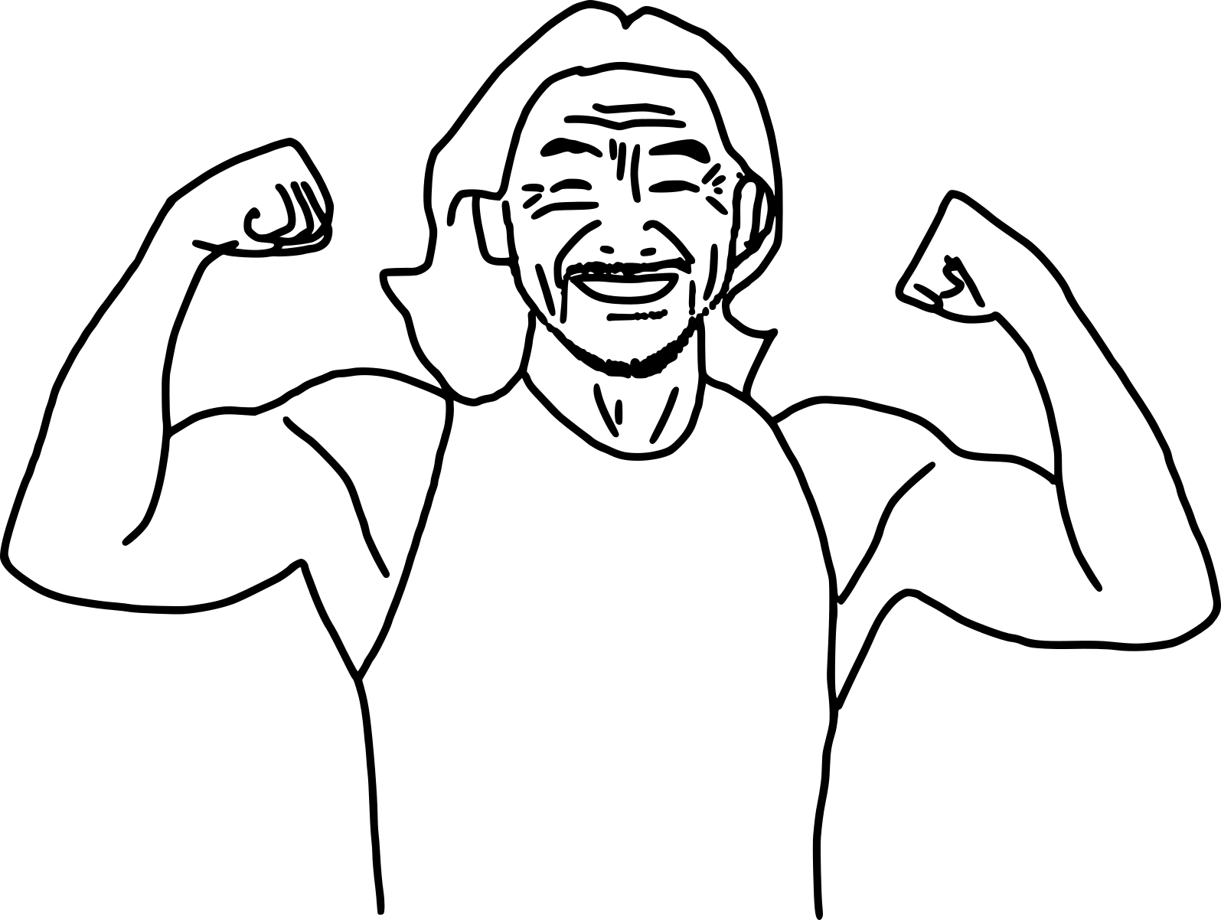
5-day Media Literacy Challenge
Day 1: Reclaim Your Focus
Day 2: Explore New Perspectives
Day 3: Go Beyond the Headlines
Day 4: Cut the Noise
Day 5: Build a Wholesome Feed
*based on the 5-day challenges from University of Maine and Dasia Sade.
https://shakeri.eu
Notes:
I also created a 5-day media literacy challenge just for you.
I clearly defined the goal for each day, with clearly defined steps.

Slide 13
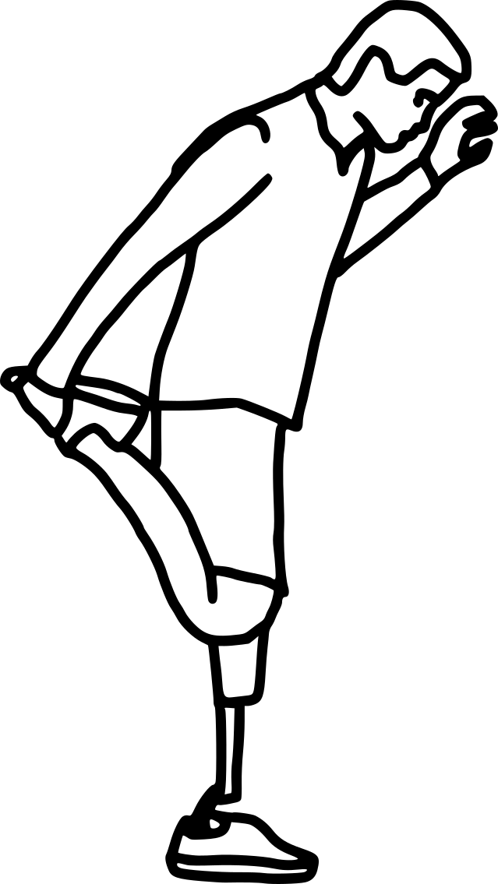
Day 1: Reclaim Your Focus
Goal: Break free from mindless scrolling and reconnect with yourself and your surroundings.
Set 3 specific times to check news (e.g., 9am, 12pm, 6pm).
Reflect: How did you feel, think, and act today?
Replace one screen habit with a non-screen activity.
https://shakeri.eu

Slide 14

Day 2: Explore New Perspectives
Goal: Get comfortable with diverse viewpoints and approach media with curiosity.
Read a news source from a different cultural or political background.
Reflect: What surprised, challenged, or intrigued you?
Fact-check one story from this source.
Share your insights with someone.
https://shakeri.eu

Slide 15

Day 3: Go Beyond the Headlines
Goal: Dive deeper into stories and recognize different angles of truth.
Compare one story across 3 outlets with differing viewpoints.
Reflect: What stood out, was missing, or felt biased?
Question assumptions, tones, and nuances.
Discuss your media journey with someone.
https://shakeri.eu

Slide 16

Day 4: Cut the Noise
Goal: Curate a media feed that informs rather than drains or manipulates.
Identify a story that prioritizes drama over value.
Reflect: Did it trigger emotions? Was that intentional? What was its purpose?
Unfollow three sources that provoke more than they inform.
https://shakeri.eu

Slide 17

Day 5: Build a Wholesome Feed
Goal: Fill your feed with content that educates, inspires, and connects.
Discover 3 news sources known for depth and fairness.
Reflect: How do they make you feel? Are you genuinely informed?
Discuss your media journey with someone.
https://shakeri.eu
Notes:
I hope this challenge will be useful to you.

Slide 18
Recommended Reading
Zuboff, Shoshana (2019):
The Age of Surveillance Capitalism: The Fight for a Human Future at the New Frontier of Power
Benjamin, Ruha (2019):
Race After Technology: Abolitionist Tools for the New Jim Code
D'Ignazio, Catherine; Klein, Lauren (2020)
Data Feminism
Monea, Alexander (2022):
The Digital Closet: How the Internet Became Straight
https://shakeri.eu
Notes:
Finally, …

Slide 19
Recommended Watching
Can’t feel nothing (2024) by David Borenstein; on Arte
Coded Bias (2020) by Shalini Kantayya; on Algorithmic Justice Leage
The Great Hack (2019) by Jehane Noujaim, Karim Amer; on Netflix
The Social Dilemma (2020) by Jeff Orlowski; on Netflix
https://shakeri.eu

Slide 20
References
Books:
Zuboff, Shoshana (2019). The Age of Surveillance Capitalism: The Fight for a Human Future at the New Frontier of Power. New York: PublicAffairs.
Srnicek, N. (2017). The Challenges of Platform Capitalism: Understanding the Logic of a New Business Model. Juncture, 23, 254-257. https://doi.org/10.1111/newe.12023
Van Dijck, José Francisca Theodora Maria, Thomas Poell, and Martijn De Waal. The Platform Society: Public Values In a Connective World. New York (N.Y.): Oxford university press, 2018.
Algorithms:
Baker, S. A. (2022). Alt. Health Influencers: how wellness culture and web culture have been weaponised to promote conspiracy theories and far-right extremism during the COVID-19 pandemic. European Journal of Cultural Studies, 25(1), 3-24. https://doi.org/10.1177/13675494211062623
Spreeuwenberg, L. (2022). The moral implications of cancel culture. Ethical Perspectives, 29(1), 89–114.
Pfundmair, M., Wood, N.R., Hales, A. & Wesselmann, E.D. (2024) How social exclusion makes radicalism flourish: A review of empirical evidence. Journal of Social Issues, 80, 341–359. https://doi.org/10.1111/josi.12520
Norris, P. (2021). Cancel Culture: Myth or Reality? Political Studies, 71(1), 145-174. https://doi.org/10.1177/00323217211037023
Hesmondhalgh, David and Campos Valverde, Raquel and Kaye, D. Bondy Valdovinos and Li, Zhongwei, The Impact of Algorithmically Driven Recommendation Systems on Music Consumption and Production: A Literature Review (February 9, 2023). UK Centre for Data Ethics and Innovation Reports, Available at SSRN: https://ssrn.com/abstract=4365916
Tong, Z., Liu, H., Feng, J., Wang, W., Wu, H. and Xu, J. (2025), Trapped by AI Recommendation: How Identity Concerns Reduce Variety-Seeking Behavior. Manage Decis Econ. https://doi.org/10.1002/mde.4524
Specifically on YouTube’s Algorithm:
Lewis, R., & Christin, A. (2022). Platform drama: “Cancel culture,” celebrity, and the struggle for accountability on YouTube. New Media & Society, 24(7), 1632-1656. https://doi.org/10.1177/14614448221099235
Jack Nicas, 2018. How YouTube Drives People to the Internet’s Darkest Corners, Google’s video site often recommends divisive or misleading material, despite recent changes designed to fix the problem. The Wall Street Journal. Here
Munger, Kevin, and Joseph Phillips. "Right-wing YouTube: A supply and demand perspective." The International Journal of Press/Politics 27, no. 1 (2022): 186-219. https://doi.org/10.1177/1940161220964767
Hana Kiros, 2022. Hated that video? YouTube’s algorithm might push you another just like it. MIT Technology Review. Here
Rieder, B., Matamoros-Fernández, A., & Coromina, Ò. (2018). From ranking algorithms to ‘ranking cultures’: Investigating the modulation of visibility in YouTube search results. Convergence, 24(1), 50-68. https://doi.org/10.1177/1354856517736982
Birchall, C., Knight, P., & Knight, S. (2024). Conspiracy Loops: From Distrust to Conspiracy to Culture Wars. Demos. https://demos.co.uk/wp-content/uploads/2024/04/Conspiracy-Loops_Report.pdf
Hazem Ibrahim, Nouar AlDahoul, Sangjin Lee, Talal Rahwan, Yasir Zaki, YouTube’s recommendation algorithm is left-leaning in the United States, PNAS Nexus, Volume 2, Issue 8, August 2023, pgad264, https://doi.org/10.1093/pnasnexus/pgad264
Yesilada M, Lewandowsky S. Systematic review: YouTube recommendations and problematic content. Internet Policy Rev. 2022 Mar 31;11(1):1652. doi: 10.14763/2022.1.1652. PMID: 36466439; PMCID: PMC7613872.
Zuboff, S. (2015). Big other: Surveillance Capitalism and the Prospects of an Information Civilization. Journal of Information Technology, 30(1), 75-89. https://doi.org/10.1057/jit.2015.5
Couldry, N., & Mejias, U. A. (2019). Data Colonialism: Rethinking Big Data’s Relation to the Contemporary Subject. Television & New Media, 20(4), 336-349. https://doi.org/10.1177/1527476418796632
West, S. M. (2019). Data Capitalism: Redefining the Logics of Surveillance and Privacy. Business & Society, 58(1), 20-41. https://doi.org/10.1177/0007650317718185
Google occasionally publishes white papers and blog posts about YouTube’s algorithm and business practices. These can be found on the Google AI Blog, YouTube’s Creator Academy, and Google Research Blog.
Icons by Larea from Noun Project (CC BY 3.0)
https://shakeri.eu

Slide 21
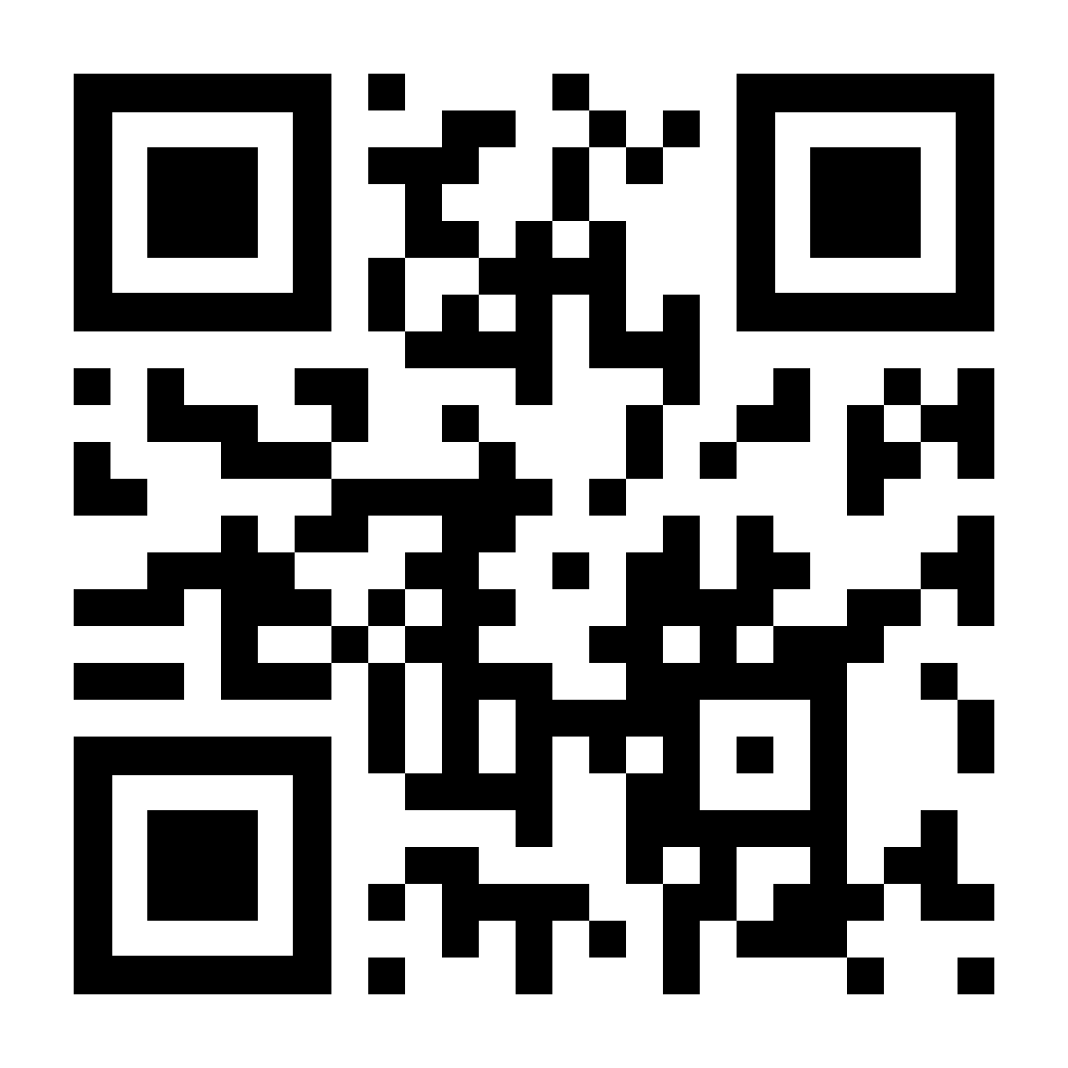


Contact
www.shakeri.eu
gozel@shakeri.eu
Notes:
I want to thank you for your attention and … Any questions?

